Slide 1
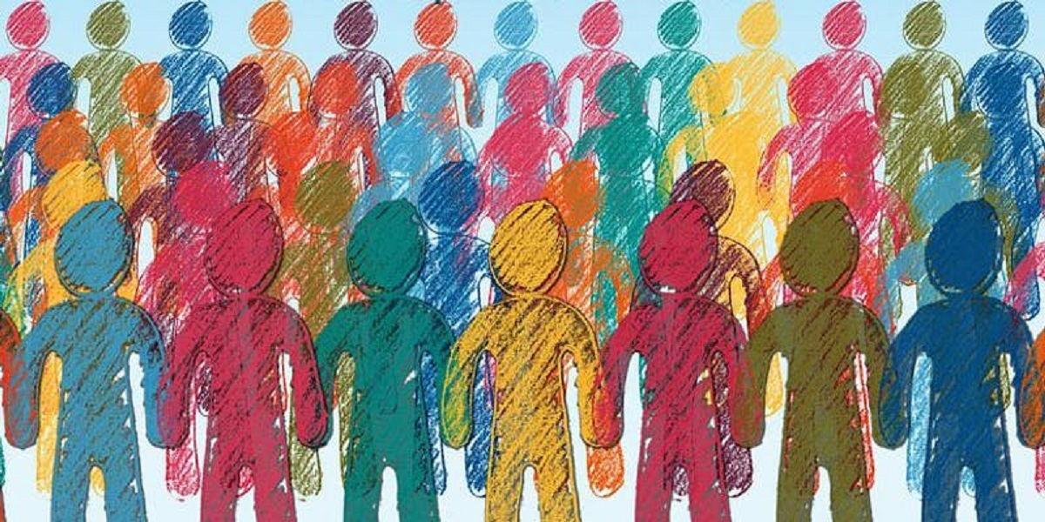
Representation By Rachel Steinberg, 3LPlace
Image: https://www.idea.int/news-media/events/representation-age-populism-ideas-global-action

Slide 2
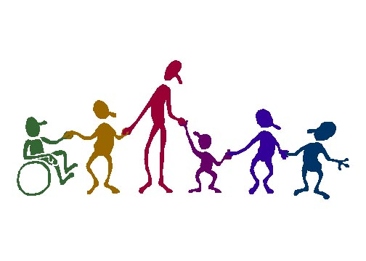
Representation:
“speaking or acting on behalf of someone”

Slide 3
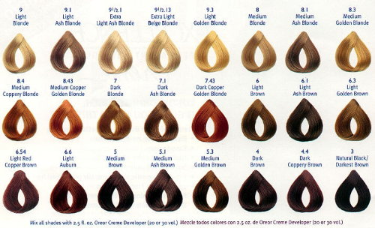
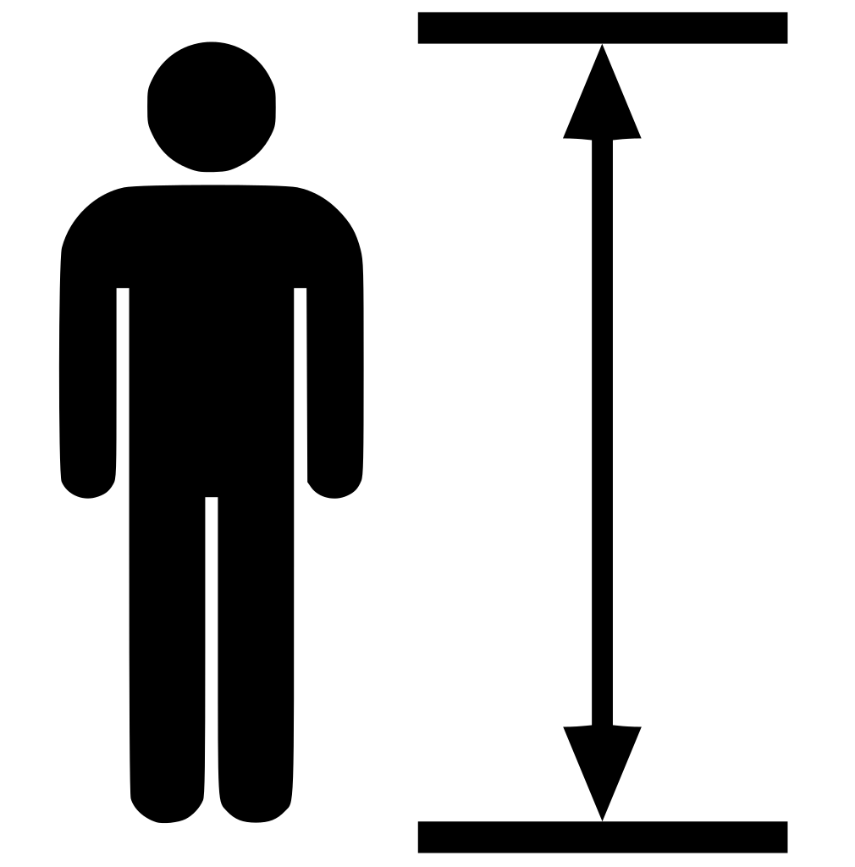
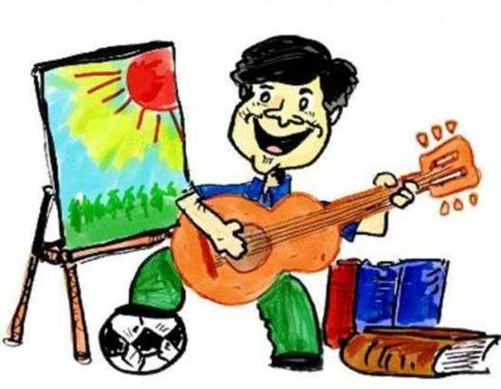
If a person has… …you might feel represented because you share something in common with that person.
the same hair color as you
the same height as you
the same interests as you

Slide 4
There other important forms of representation:

Slide 5
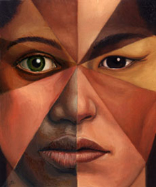
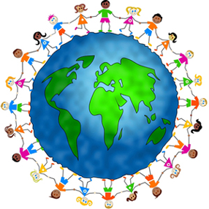
Do you see anyone who shares your race or ethnicity …On the street? …In your program? …In the media? …At work?
Racial/Ethnic Representation:
Image: https://en.wikipedia.org/wiki/Crazy_Rich_Asians_(film)

Slide 6
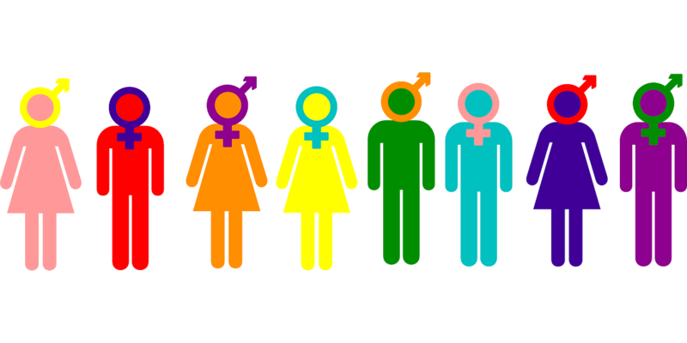
Do you see someone who has the same gender identity as you… …On the street? …At your program? …In the media? …At work?
Gender Identity Representation:

Slide 7
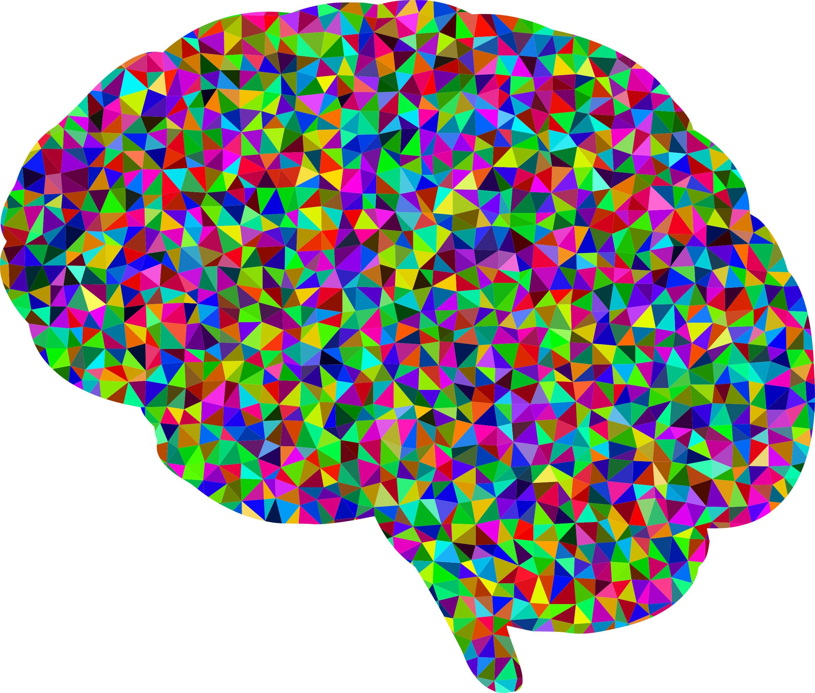
Neurodiversity Representation:
Do you see someone with autism, developmental disabilities, movement disorders, etc….
…on the street?
…In your program?
…In the media?
…At work?

Slide 8
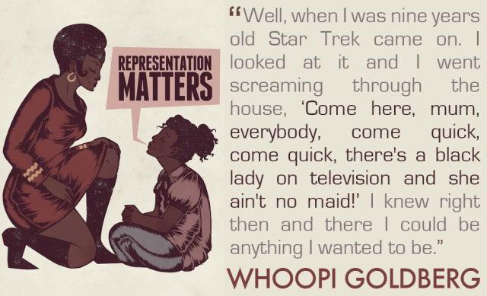
So…why is representation important?
Image: https://rhulth.wordpress.com/2018/03/13/representation-matters/

Slide 9
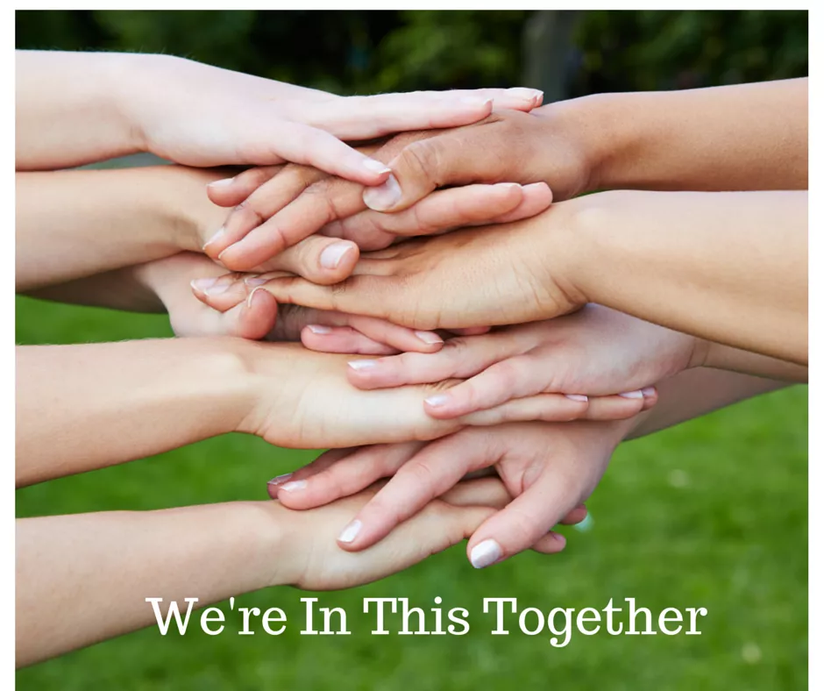
When there is more representation, the world becomes a more equal place. This is important in the Work and Career Module because it is powerful to know that we are not alone. Our struggles and triumphs are shared.
Image: http://wineinmom.com/2015/01/were-in-this-together/

Slide 10
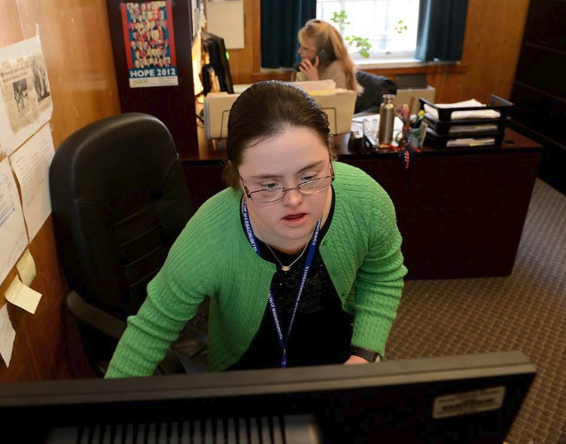
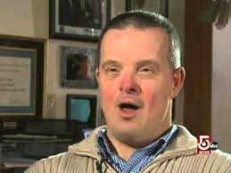
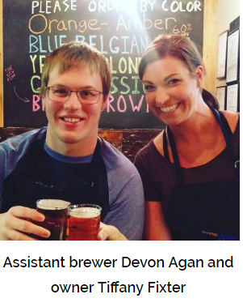
When we see people like us, doing things that we want to do, we know that we can do them too.
Image: https://www.metrowestdailynews.com/article/20140222/NEWS/140228579
Image: https://www.youtube.com/watch?v=PXIoYZa_Uzw
Melissa Reilly and John Anton who work at the Massachusetts State House
Images: https://www.brewabilitylab.com/
Brewability Video 1
Brewability Video 2
Melissa Reilly Video
John Anton Video

